Slide 1
Text Recognition using ML
Objective: To easify the digitization process.
College Name: N. B. Navale Sinhgad College of Engineering Solapur.
Department : Computer Science and Engineering.
Guide: Prof Maindargi L C.
Group members :
Mr. | Prathmesh Yakkaldevi | Roll no. 55
Mr. | Akshay Manekari | Roll no. 56
Mr. | Saitarun Patel | Roll no. 57
Mr. | Shahrukh Shaikh | Roll no. 58
Mr. | Shrikant Gullapalli | Roll no. 59

Slide 2
INTRODUCTION
> Rise of Internet, Digitization and Digital Epoch
> Rise of Artificial Intelligence
> Idea and Objective of our Project

Slide 3
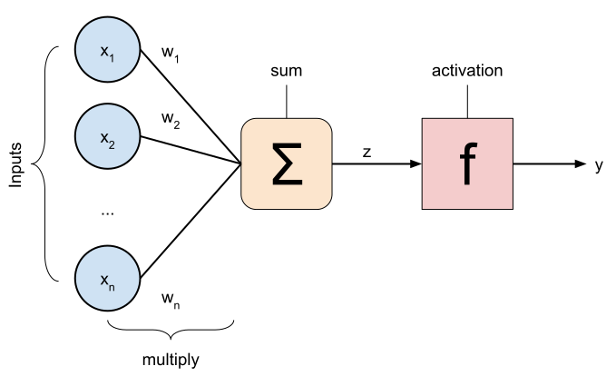
Literature Survey
Artificial neural networks (ANNs), usually simply called Neural Networks (NNs), are computing systems vaguely inspired by the biological neural network that constitute animal brains.
z = (weights(T) * input) + bias
a = y = s( z )

Slide 4
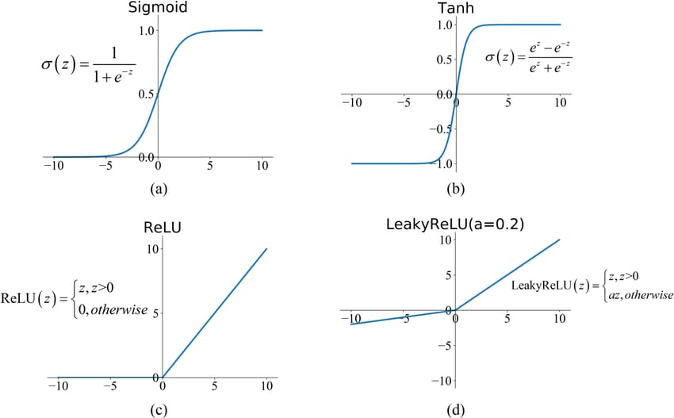
Literature Survey
Activation's:

Slide 5
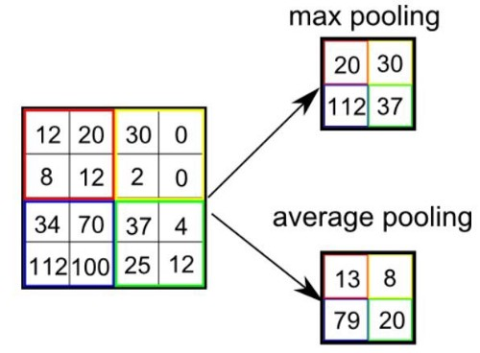
Literature Survey
Convolutional Neural Networks:

Slide 6
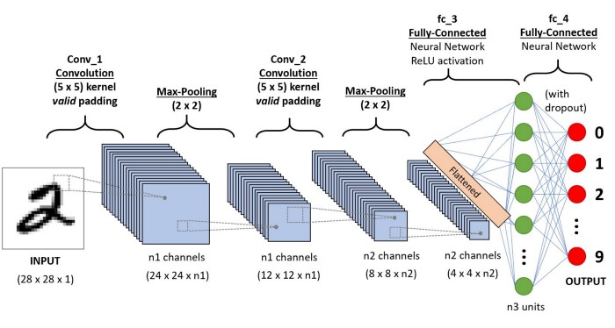
Literature Survey

Slide 7
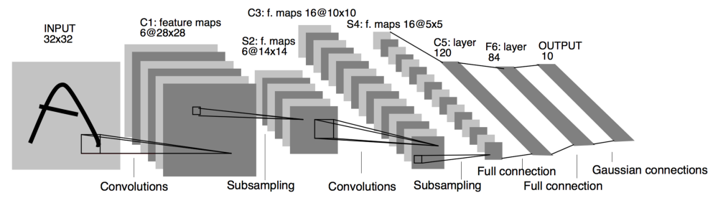
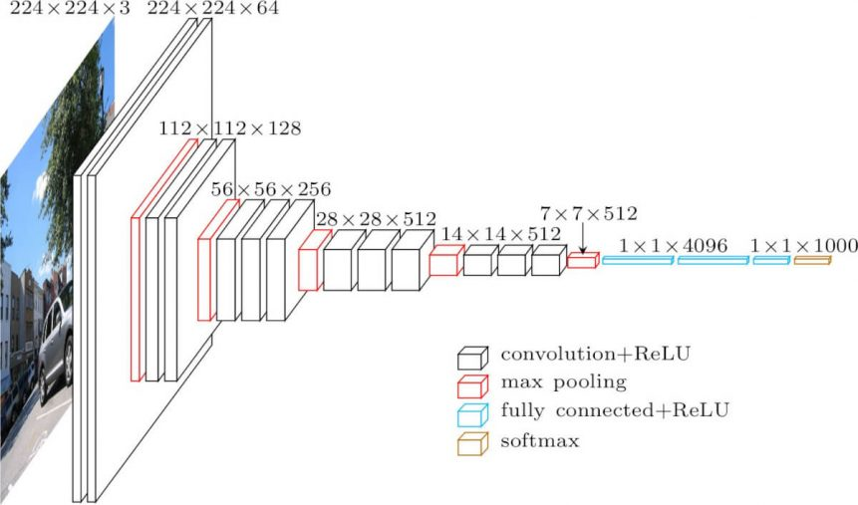
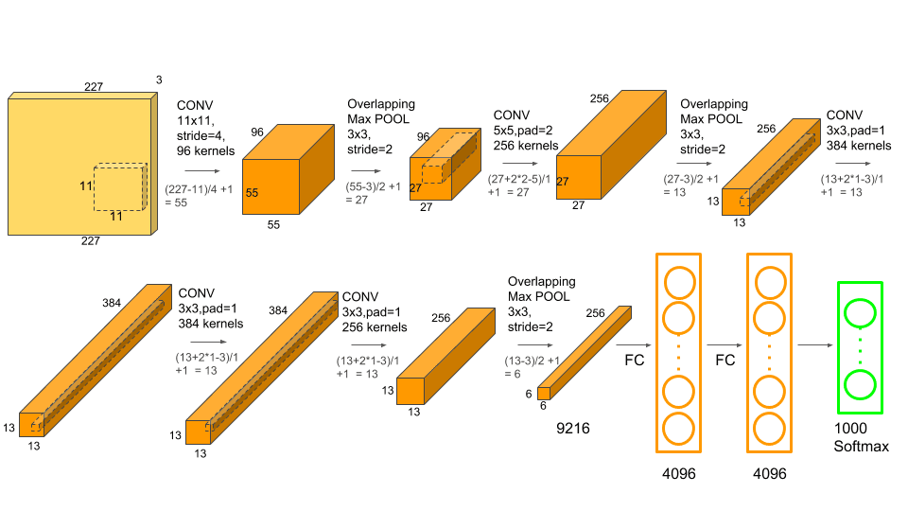
Literature Survey

Slide 8
METHODOLOGY
GRAPHICAL USER INTERFACE :
> Why bother about GUI ?
> Platforms and tools Used to develop GUI
> Libraries : Tkinter, OS, Sub process
> GUI components : Frames, Buttons, Cascading Menus, User Prompts, Surfing Directories

Slide 9
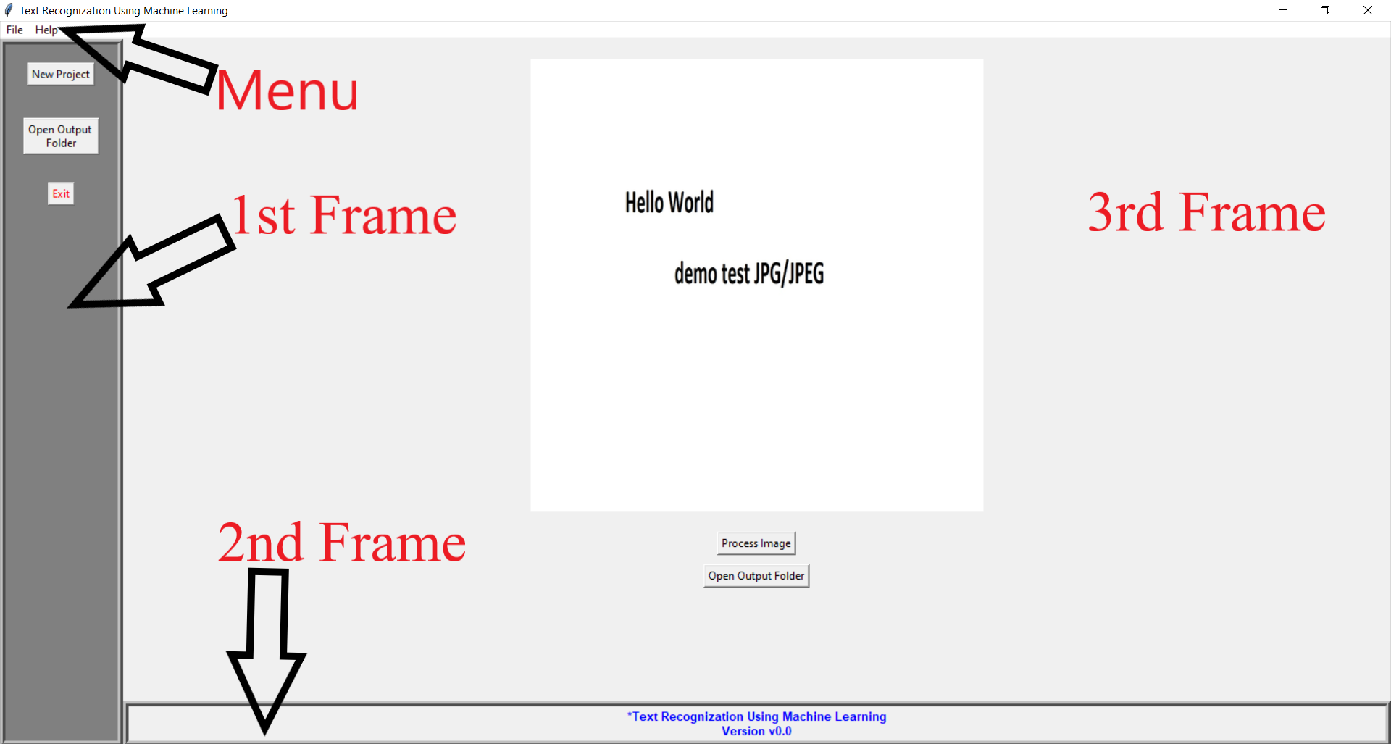
METHODOLOGY
GRAPHICAL USER INTERFACE :

Slide 10
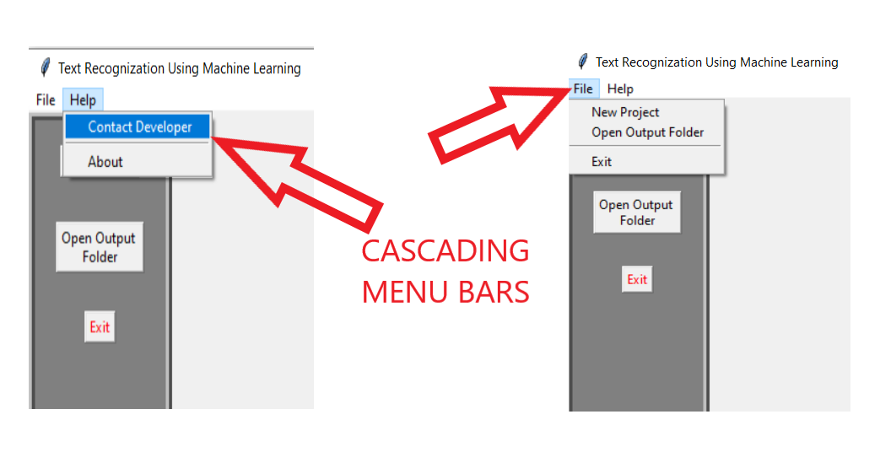
METHODOLOGY
GRAPHICAL USER INTERFACE : Cascading Menus

Slide 11
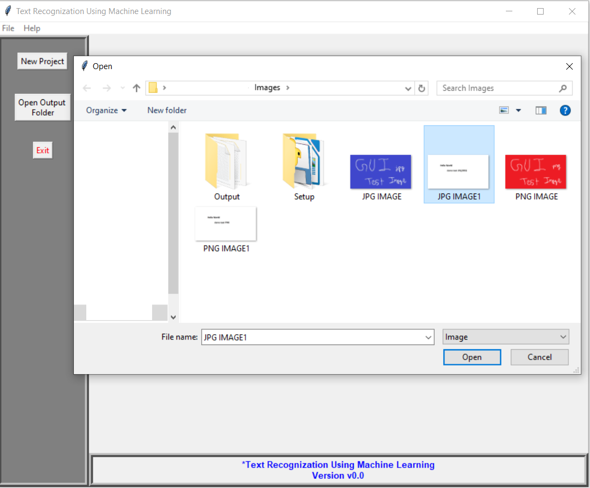
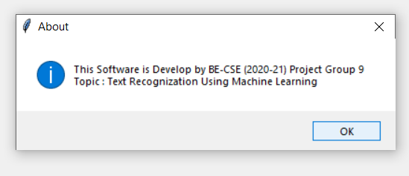
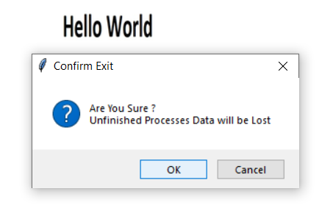
METHODOLOGY
GRAPHICAL USER INTERFACE : Directory Surfing and User Prompts

Slide 12
METHODOLOGY
CROPPING IMAGES :
> Why Cropping is needed ?
> Libraries Used : Tkinter, OpenCV
> How to Crop Image ?
> Conclusion

Slide 13
METHODOLOGY
CONVERTING IMAGE TO BLACK AND WHITE :
> The process of predicting characters from the images becomes a lot eariser if the images are in black and white instead of colour.
> Images according to our project can be of three types : low light, normal light, bright light
> For low_light images = Push alpha values to higher end
> For bright_light images = Push alpha values to lower end

Slide 14
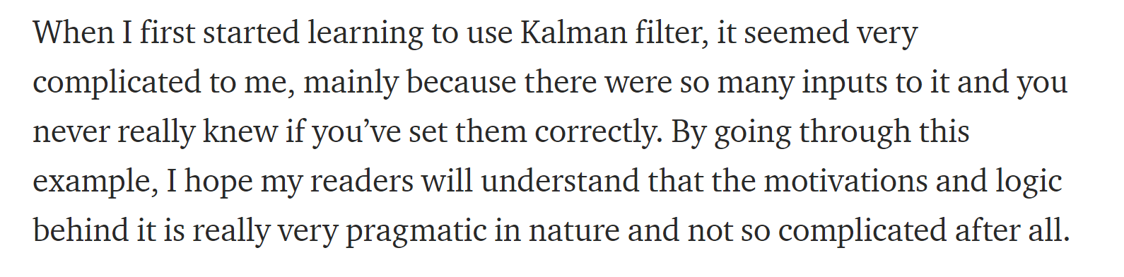
METHODOLOGY
SEPARATING CHARACTERS

Slide 15
METHODOLOGY
SEPARATING CHARACTERS

Slide 16










METHODOLOGY
SEPARATING CHARACTERS

Slide 17






METHODOLOGY
SEPARATING CHARACTERS

Slide 18
METHODOLOGY
ML CHARACTER PREDICTING MODELS :
We made a classification model consisting of 3 CONV layers, 2 Dense layers which takes each image created by the previous phase as input individually and outputs a 26 values python list.
word_dict = { 1: 'a', 2: 'b', 3: 'c', 4: 'd', 5: 'e', 6: 'f', 7: 'g', 8: 'h', 9: 'i', 10: 'j',
11: 'k', 12: 'l', 13: 'm', 14: 'n', 15: 'o', 16: 'p', 17: 'q', 18: 'r', 19: 's', 20: 't',
21: 'u', 22: 'v', 23: 'w', 24: 'x', 25: 'y', 26: 'z' }

Slide 19
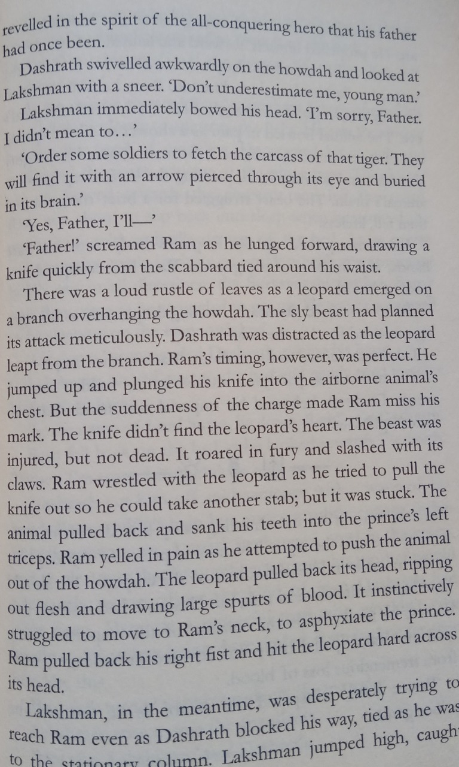
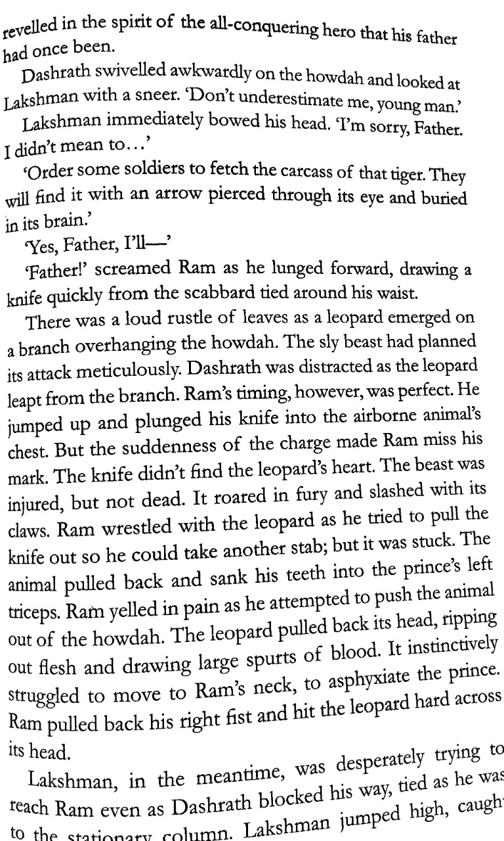
EXPERIMENTATION
INPUT
OUTPUT

Slide 20
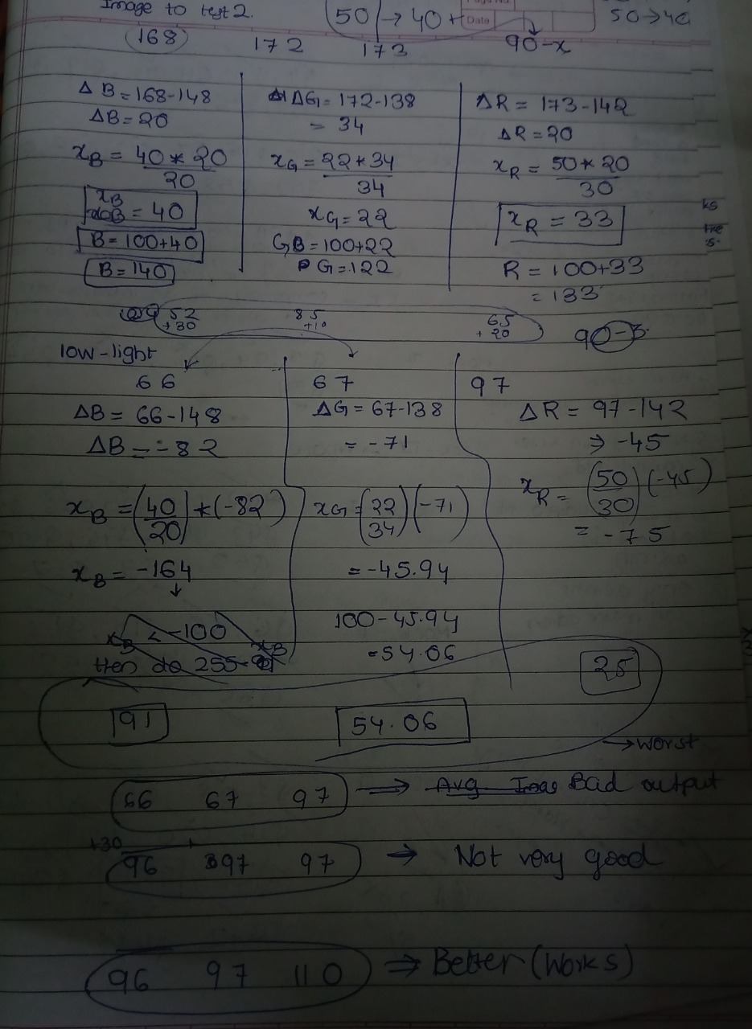
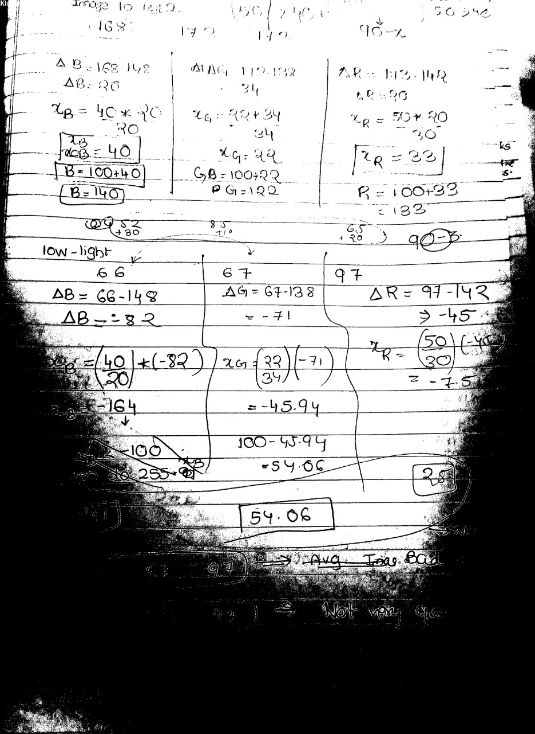
EXPERIMENTATION
INPUT
OUTPUT

Slide 21
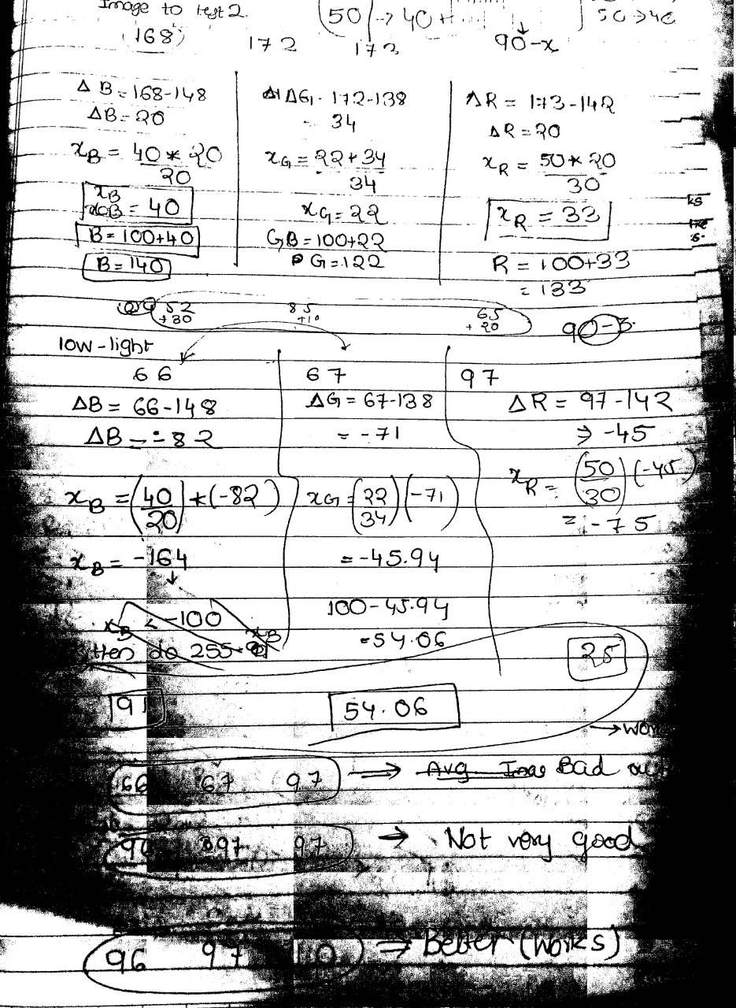
EXPERIMENTATION
INPUT
OUTPUT

Slide 22
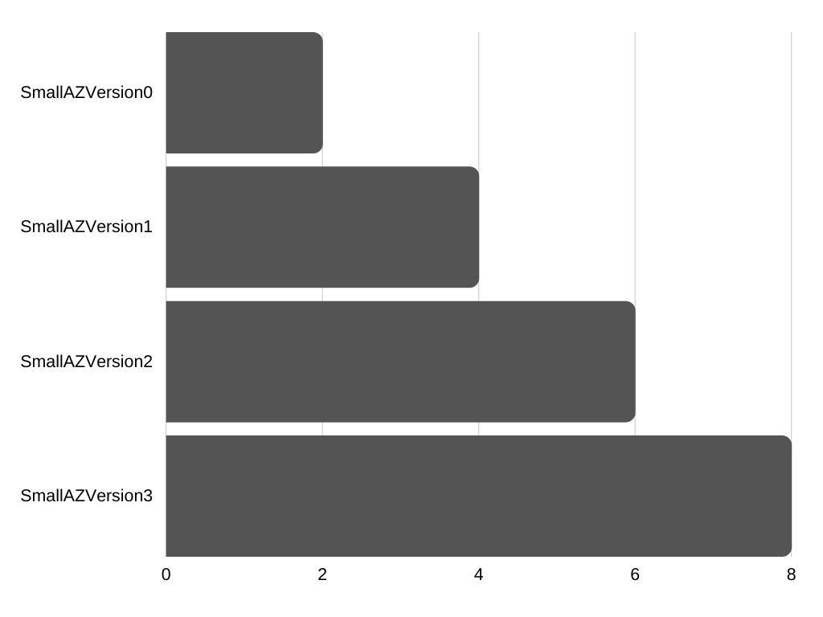
EXPERIMENTATION

Slide 23
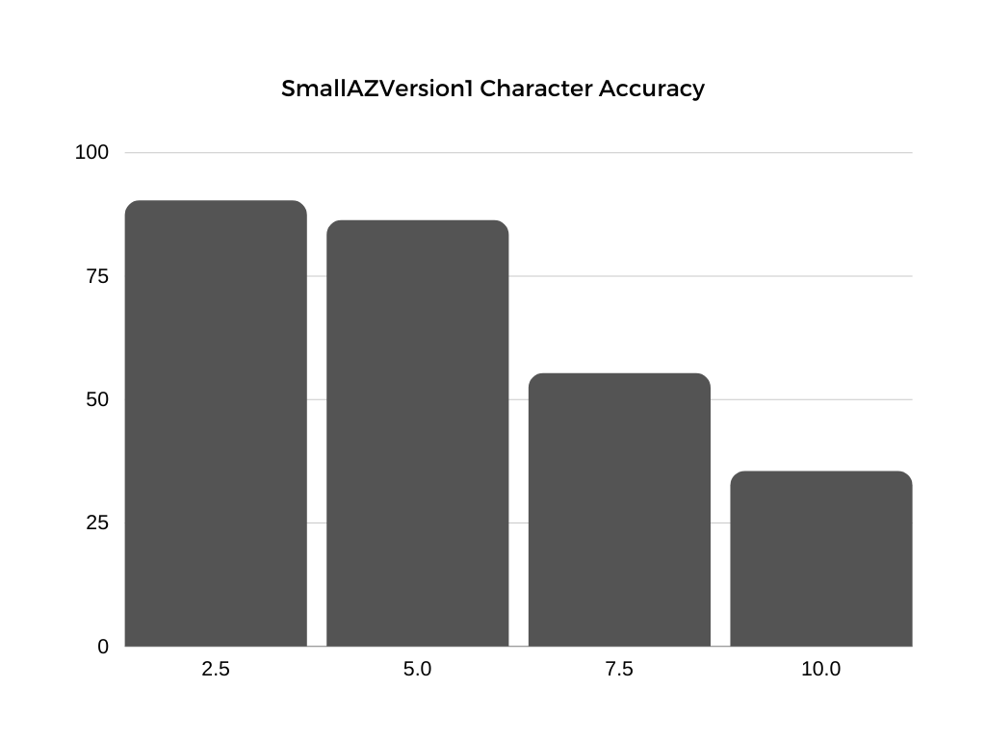
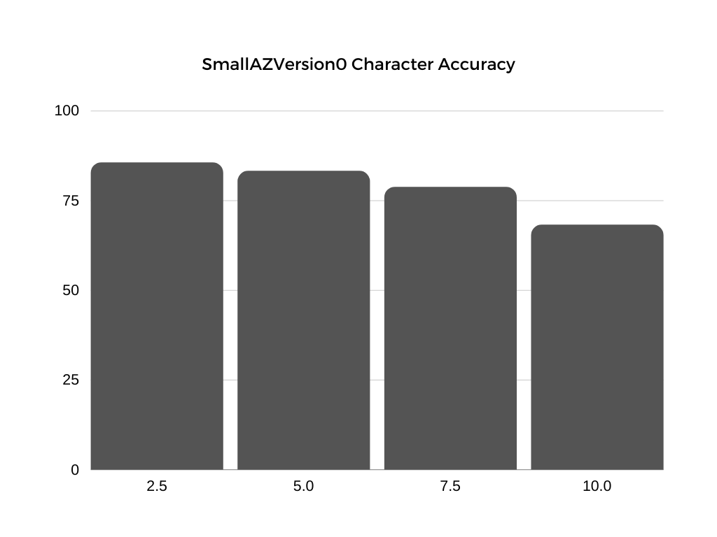
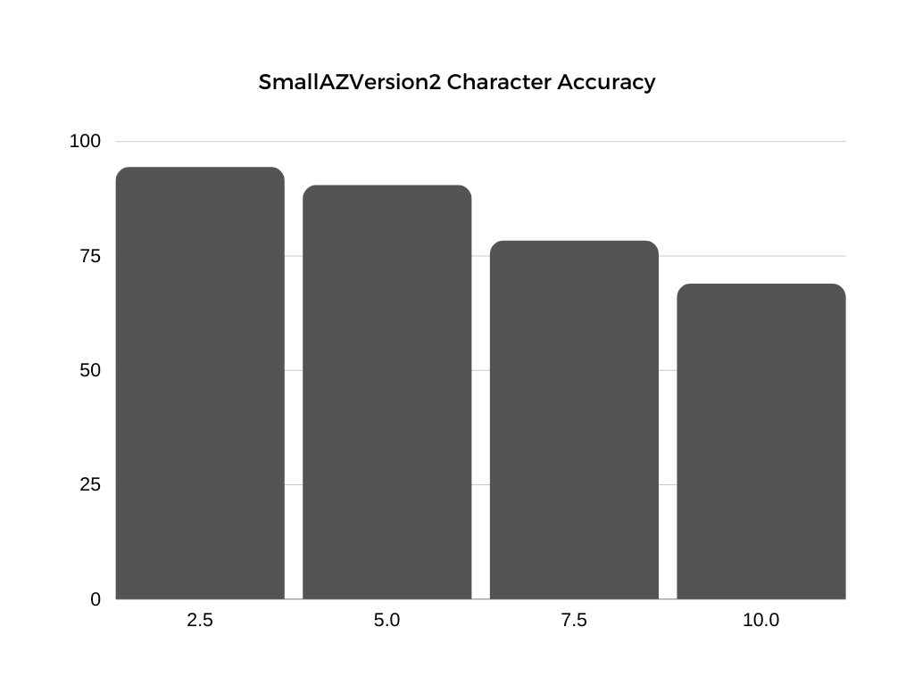
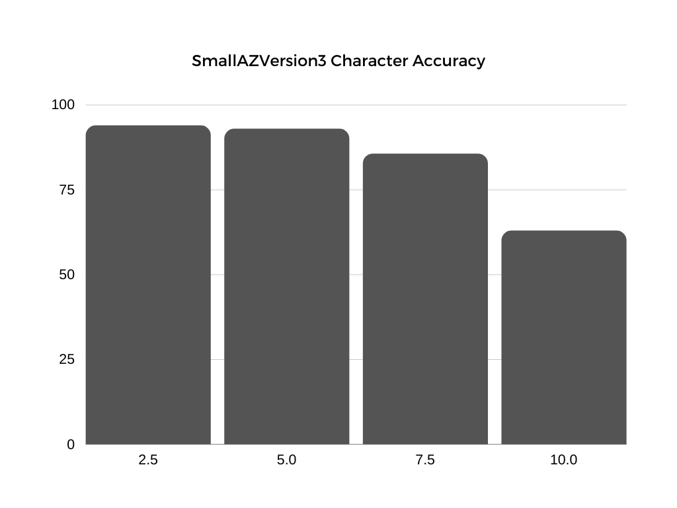

Slide 24





RESULTS and discussion

Slide 25


Results and discussion
half printed characters
complex formula

Slide 26
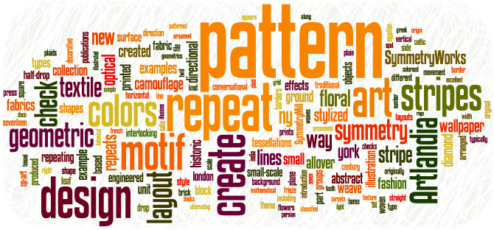
Results and discussion
Irregular pattern of words

Slide 27
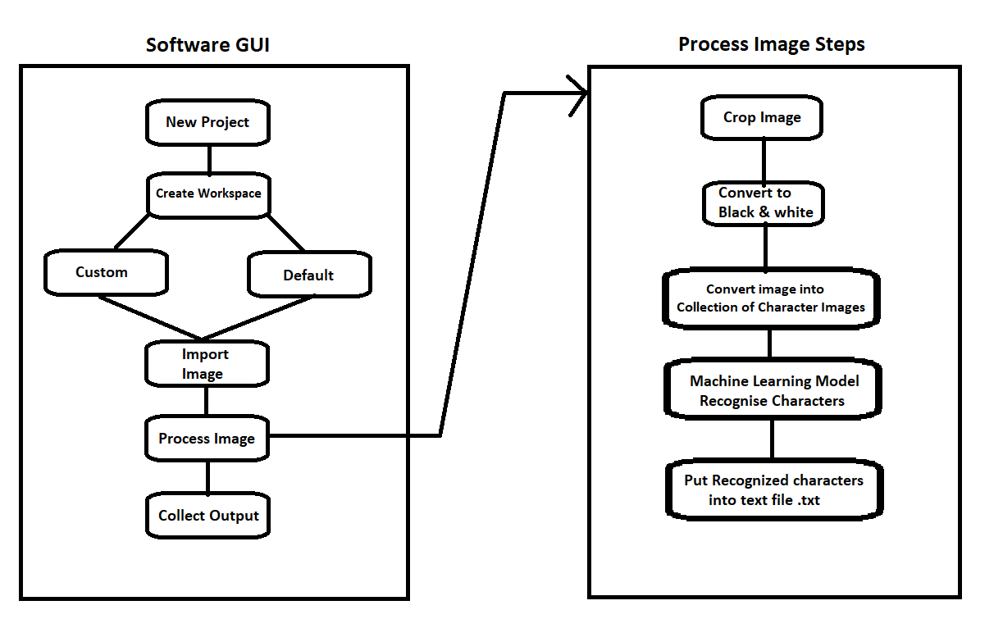
PROJECT ARCHITECTURE

Slide 28
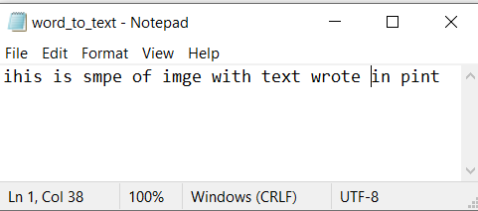
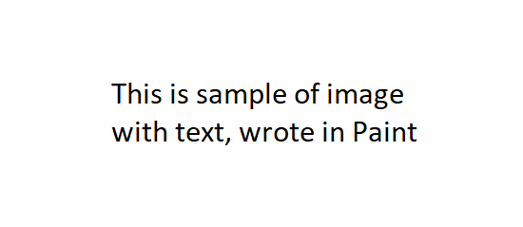
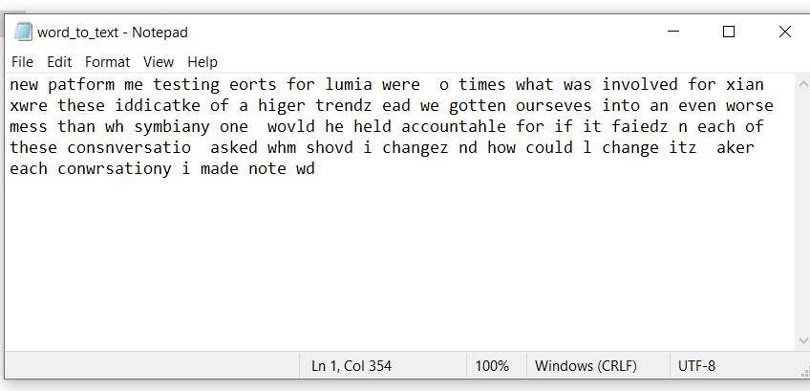
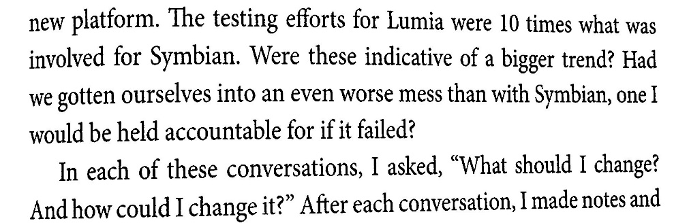
CONCLUSION

Slide 29
End of PPT
THANK YOU

